Slide 1
Deployment Project Loan Eligibility
By: Josh Ho

Slide 2
Agenda
Project Workflow
Hypothesis
EDA
Model Building
Pipelines & Optimization
Conclusion

Slide 3




Project Workflow
1
2
3
4
Data Retrieval
Data Preparation
Modeling &
Pipeline
Evaluating/Tuning
Iterative Process
Notes:
Step 1 was data retrieval, which included downloading and previewing our loan data
Step 2 was data preparation, this involved the cleaning and transformation of the several datasets collected, culminating in thousands of rows and tens of columns to perform our modelling on. It required many forms of data wrangling techniques (ex. Dealing with nulls)
Step 3 was modeling with logistic regression, which involved the splitting of data into test and train sets, then scaling numeric features, and encoding categorical features, then undergoing feature selection, and finally outputting the models prediciton, then using a pipelien to consolidate all the steps prior to and including this one into a pipeline for efficiency and optimization purposes
Step 4 was evaluation and tuning, where different metrics were used to critique the efficiency of the pipeline, as well as investigate different outcomes by tuning the pipelines hyperparameters with grid search
This workflow was iterative in nature

Slide 4

Hypothesis
Objective
Predict whether an applicant is eligible for a loan based on their provided data
Hypothesis
Applicants that:
Have High Pay
Have Credit History
Completed Formal Education
Reside in a Developed Area
Are more likely to be eligible for a loan
Notes:
However, overall I believe that applicants who have credit history, have a higher income, higher education, and live in a developed area will be more likely to be granted a loan.
This is because a credit history likely provides a proven track record of financial acumen, a higher income likely means a greater ability to repay the loan, a higher education likely means an access to better resources, and living in a developed area likely means having an established and safe community to reside in. All these things when combined together point to an applicant who likely has a more financially stable and privileged background.

Slide 5
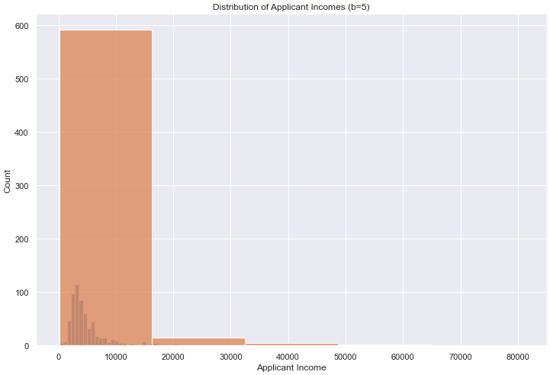
EDA Distribution of Applicant Incomes
Notes:
Bins = 5
Applicant income data was heavily right skewed, with the vast majority (500+) of applicants making $18000 or less dollars

Slide 6
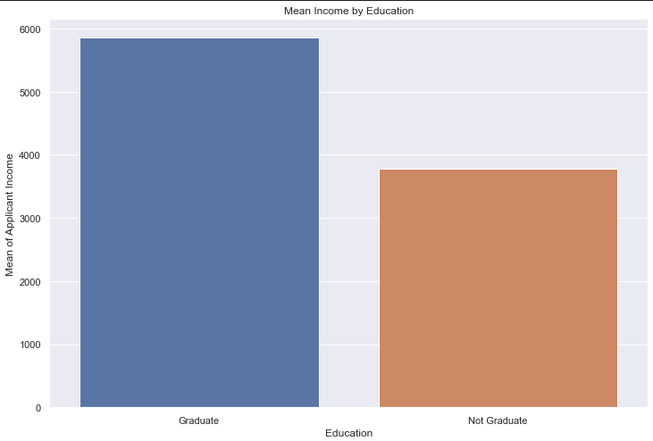
Mean Income by Education
Notes:
Applicants who graduated from post-secondary education tend to make almost $2000 more on than applicants who do not

Slide 7
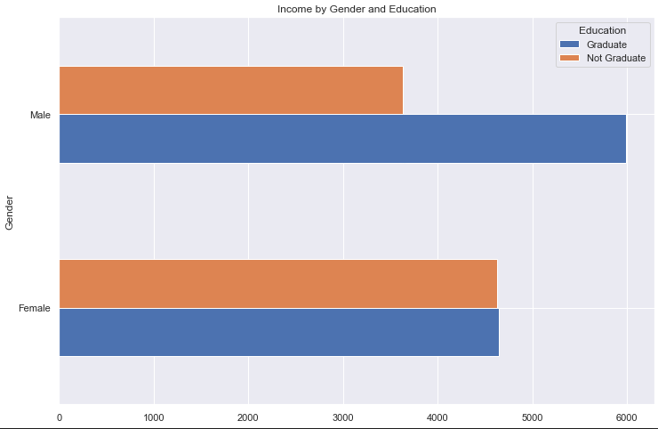
Income by Gender and Education
Notes:
Male applicants who graduated make more than males who have not graduated, and females in general. Whereas females in general make more than males who did not graduate.

Slide 8
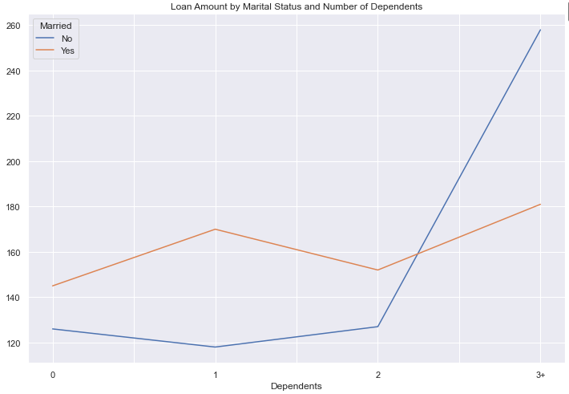
Loan Amount by Marital Status and Number of Dependents
Notes:
Applicants who were married and had 3+ dependents applied for much higher loans than those who were married or unmarried with less than 3 children.

Slide 9
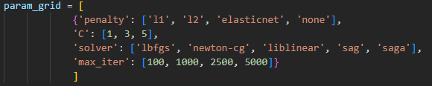
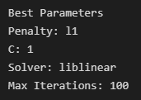
Model Building
Model Details
Model Outputs
Train/Test = 80/20
Numeric Features MinMax Scaling
Categorical Features One-Hot-Encoding
Feature Selection PCA (n= 3)
Model Logistic Regression
Before Grid Search (Hyper Parameter Tuning) Accuracy 71.54%
After Grid Search Accuracy 71.54%
The Same!

Slide 10
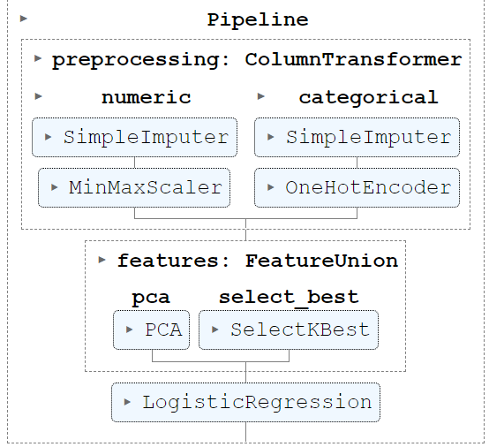

Pipelines & Optimization
Before Grid Search Accuracy: 84.55%
After Grid Search Accuracy: 85.37% (+0.82%)
Pipeline increased accuracy of previous model (unoptimized) by +13.01%
Optimized pipeline increased accuracy of previous model (optimized) by +13.83%
Notes:
However, after consolidating my data cleaning, feature engineering, feature selection, and model building into a pipeline, I was able to achieve an 84.55% accuracy on my test set and an 80.65% accuracy on my train set. A 13% improvement versus my initial model! And with grid search, I was able to achieve 85.37% on my test set, which is an improvement of 0.82% off my pipeline model’s train set. However, there is a slightly lesser performance on my train set versus my test set, which could suggest an underlying issue.

Slide 11
Conclusion
Ideally!
Based on the a sample row of data given, our model proves our hypothesis correct, in which applicants who meet a certain criteria are more likely to be granted a loan

Slide 12
Thank You for Listening!

